Slide 1
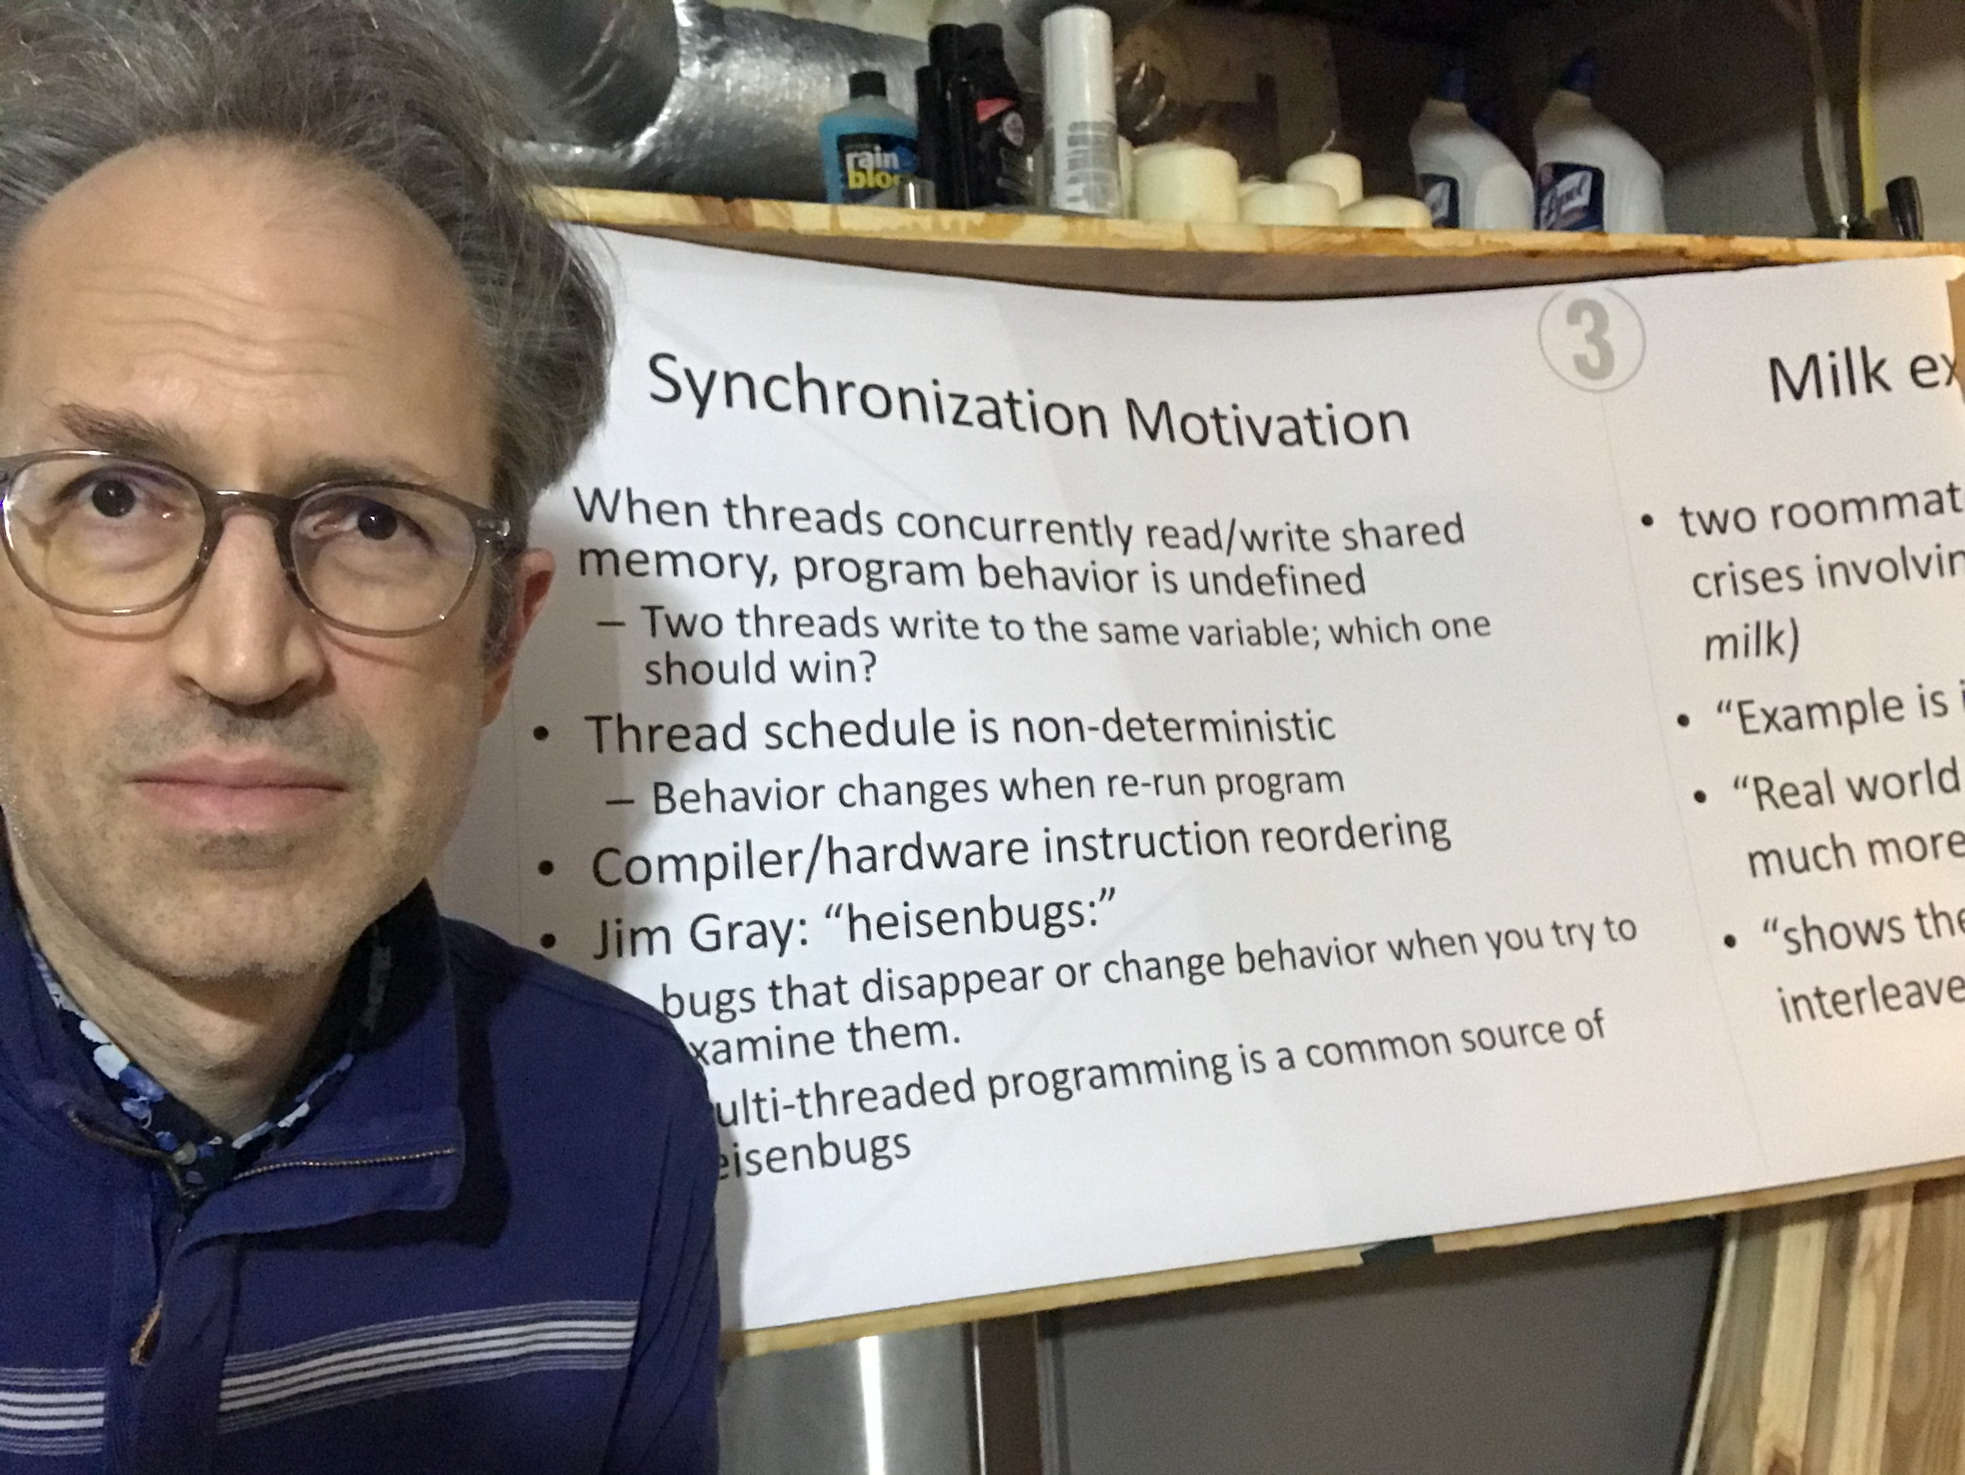

Slide 2
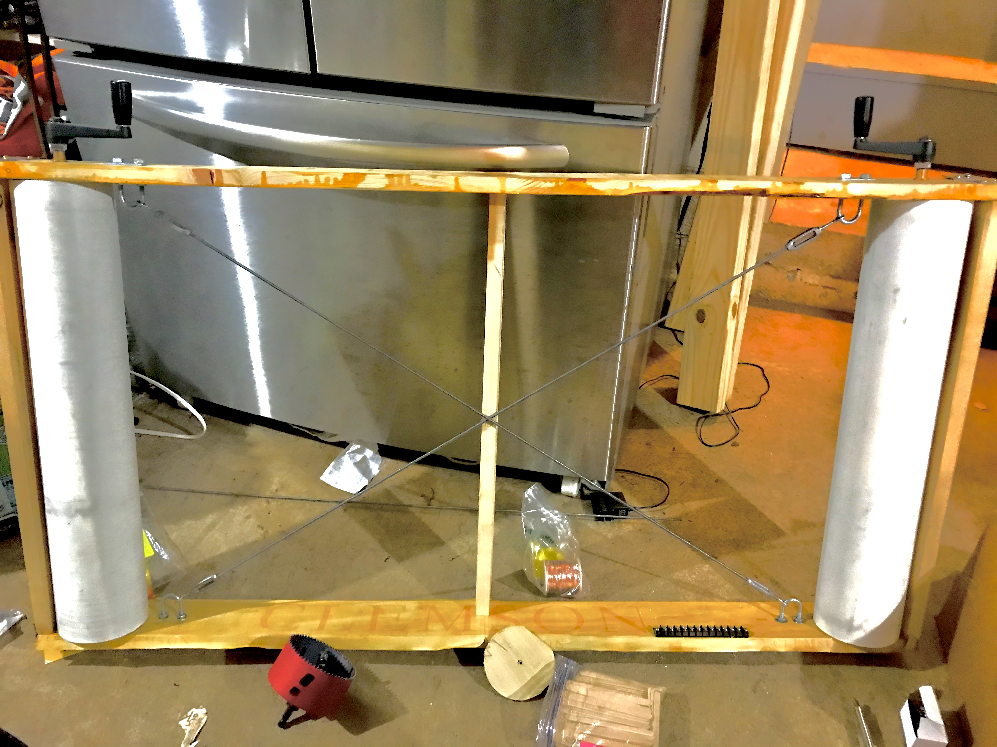

Slide 3
Synchronization
Notes:
NOTE to instructors: it is helpful to walk through an example such as readers/writers locks for illustrating the use of condition variables. I haven’t included it in these slides, as I usually take a class to do that example on the board – showing what happens as multiple threads stop at various points during the execution and other threads run.

Slide 4
Synchronization Motivation
When threads concurrently read/write shared memory, program behavior is undefined
Two threads write to the same variable; which one should win?
Thread schedule is non-deterministic
Behavior changes when re-run program
Compiler/hardware instruction reordering
Jim Gray: “heisenbugs:”
bugs that disappear or change behavior when you try to examine them.
Multi-threaded programming is a common source of Heisenbugs
Notes:
To solve any of these, you need synchronization.
You want program behavior to be a specific function of input – not of the sequence of who went first.
You want the behavior to be deterministic – not to vary from run to run
Even if you ignore those, the compiler will mess you up bad (compared to what you think will happen)
And even If you ignore that, the hardware will mess you up bad.

Slide 5
Why Reordering?
Why do compilers reorder instructions?
Efficient code generation requires analyzing control/data dependency
If variables can spontaneously change, most compiler optimizations become impossible
Why do CPUs reorder instructions?
Write buffering: allow next instruction to execute while write is being completed
Notes:
I get this question a lot, since it seems so counter-intuitive for compilers to do this to you! But they don’t know you are running multiple threads, and even if they did, it would slow them down a lot if they couldn’t move things around

Slide 6
Milk example motivation
two roommates who share fridge, want to avoid crises involving cereal, coffee (don’t run out of milk)
“Example is intentionally simple”
“Real world concurrent programs are often much more complex;” but
“shows the difficulty of reasoning about interleaved access to shared state.”
Notes:
To solve any of these, you need synchronization.
You want program behavior to be a specific function of input – not of the sequence of who went first.
You want the behavior to be deterministic – not to vary from run to run
Even if you ignore those, the compiler will mess you up bad (compared to what you think will happen)
And even If you ignore that, the hardware will mess you up bad.

Slide 7
Too Much Milk Example
 | Person A | Person B
12:30 | Look in fridge. Out of milk.
12:35 | Leave for store.
12:40 | Arrive at store. | Look in fridge. Out of milk.
12:45 | Buy milk. | Leave for store.
12:50 | Arrive home, put milk away. | Arrive at store.
12:55 |  | Buy milk.
1:00 |  | Arrive home, put milk away. Oh no!

Slide 8
Too Much Milk, Try #1
Correctness* property
Someone buys if needed (liveness)
At most one person buys (safety)
Try #1: leave a note
if (!note)
if (!milk) {
leave note
buy milk
remove note
}
Notes:
What can go wrong?
Thread A, Thread B

Slide 9
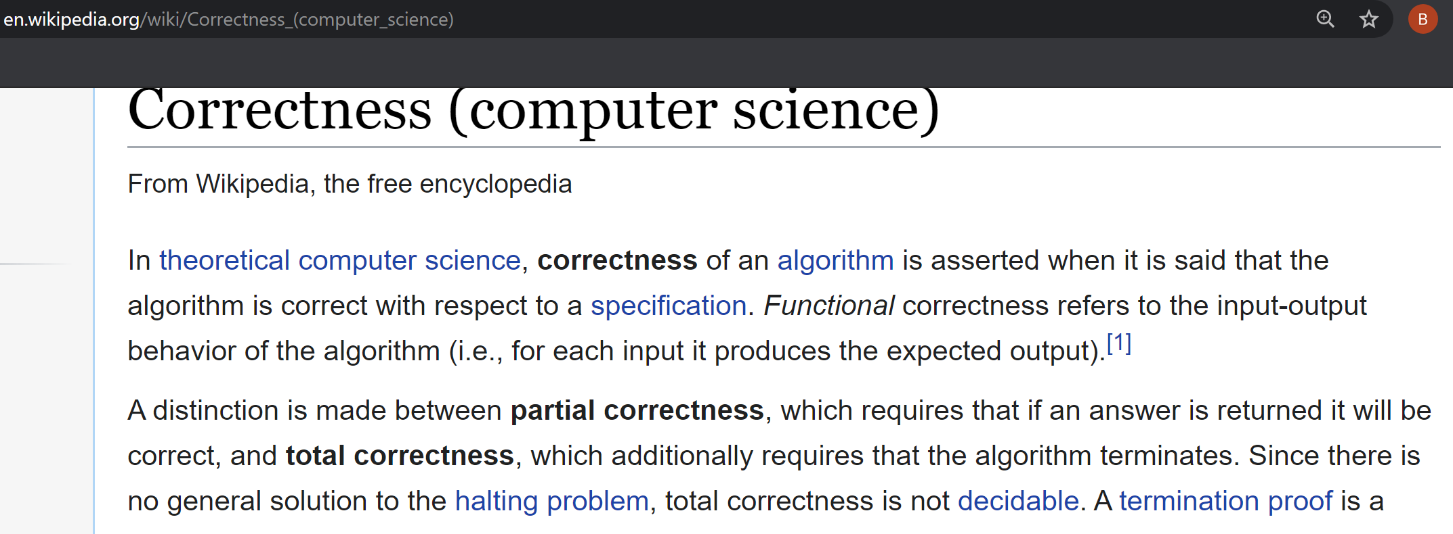

Slide 10
”strive for following properties”
safety: never more than one person buys milk
liveness: if milk is needed, someone eventually buys it
“WARNING: Simplifying assumption:
we assume instructions are executed in order written
Many compilers, architectures violate this assumption
Be extremely careful applying the style of analysis we present here to your own programs”

Slide 11
Definitions
Race condition: output of a concurrent program depends on the order of operations between threads
Mutual exclusion: only one thread does a particular thing at a time
Critical section: piece of code that only one thread can execute at once
Lock: prevent someone from doing something
Lock before entering critical section, before accessing shared data
Unlock when leaving, after done accessing shared data
Wait if locked (all synchronization involves waiting!)

Slide 12
Too Much Milk, Try #2
Thread A
leave note A
if (!note B) {
if (!milk)
buy milk
}
remove note A
Thread B
leave note B
if (!noteA) {
if (!milk)
buy milk
}
remove note B
Notes:
What can go wrong? Starvation

Slide 13
Too Much Milk, Try #2; sigh
Solution 1: check for note before writing one
Solution 2: write note before checking
Solution #2 does not ensure liveness
Possible for:
both threads to set their respective notes;
each thread to check the other thread’s note; and
both threads to decide not to buy milk
Notes:
What can go wrong? Starvation

Slide 14
Too Much Milk, Try #3
Thread A
leave note A
while (note B) // X
do nothing;
if (!milk)
buy milk;
remove note A
Thread B
leave note B
if (!noteA) { // Y
if (!milk)
buy milk
}
remove note B
Can guarantee at X and Y that either:
Safe for me to buy
Other will buy, ok to quit
Notes:
At Y: if noNote A, safe for B to buy (means A hasn't started yet)
if note A, A is either buying, or waiting for B to quit,
so ok for B to quit
At X: if nonote B, safe to buy
if note B, don't know. A hangs around. Either:
if B buys, done
if B doesn't buy, A will.

Slide 15
Too Much Milk, Try #3; sigh
Complex
Inefficient
Busy-waiting
May fail if compiler or hardware reorders
Notes:
What can go wrong? Starvation

Slide 16
Lessons
Solution is complicated
“obvious” code often has bugs
Modern compilers/architectures reorder instructions
Making reasoning even more difficult
Generalizing to many threads/processors
Even more complex: e.g., Peterson’s algorithm

Slide 17
Locks
Lock::acquire
wait until lock is free, then take it
Lock::release
release lock, waking up anyone waiting for it
At most one lock holder at a time (safety)
If no one holding, acquire gets lock (progress)
If all lock holders finish and no higher priority waiters, waiter eventually gets lock (progress)
Notes:
Bounded waiting

Slide 18
Rules for Using Locks
Lock is initially free
Always acquire before accessing shared data structure
Beginning of procedure!
Always release after finishing with shared data
End of procedure!
Only the lock holder can release
DO NOT throw lock for someone else to release
Never access shared data without lock
Danger!

Slide 19
Too Much Milk, #4
Locks allow concurrent code to be much simpler:
lock.acquire();
if (!milk)
buy milk
lock.release();

Slide 20
Condition Variables
Waiting inside a critical section
Called only when holding a lock
Wait: atomically release lock and relinquish processor
Reacquire the lock when wakened
Signal: wake up a waiter, if any
Broadcast: wake up all waiters, if any

Slide 21
Condition Variables
ALWAYS hold lock when calling wait, signal, broadcast
Condition variable is sync FOR shared state
ALWAYS hold lock when accessing shared state
Condition variable is memoryless
If signal when no one is waiting, no op
If wait before signal, waiter wakes up
Wait atomically releases lock
What if wait, then release?
What if release, then wait?

Slide 22
Condition Variables, cont’d
When a thread is woken up from wait, it may not run immediately
Signal/broadcast put thread on ready list
When lock is released, anyone might acquire it
Wait MUST be in a loop
while (needToWait()) {
condition.Wait(lock);
}
Simplifies implementation
Of condition variables and locks
Of code that uses condition variables and locks

Slide 23
Remember the rules
Use consistent structure
Always use locks and condition variables
Always acquire lock at beginning of procedure, release at end
Always hold lock when using a condition variable
Always wait in while loop
Never spin in sleep()

